Slide 1
Detailed Markov Model

Slide 2
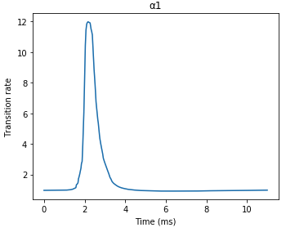
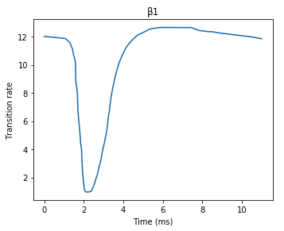
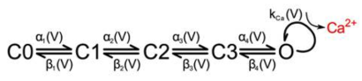
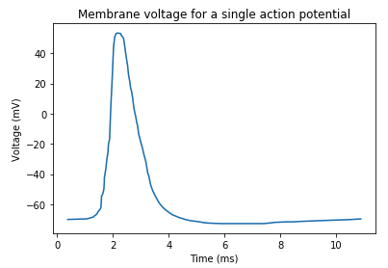
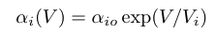
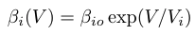
Voltage-Gated Calcium Channel
Transition rates:
Transition probabilities:

Slide 3
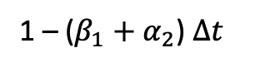
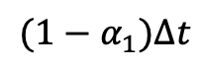
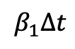
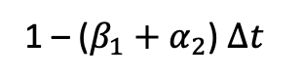
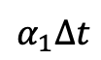
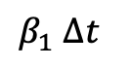
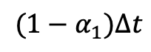
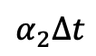
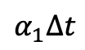
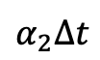
Voltage-Gated Calcium Channel
C0
t0
C0
$$α_{1}∆t$$
C1
$$α_{1}∆t$$
$${(1−α}_{1})∆t$$
t1
$${(1−α}_{1})∆t$$
1 – ($β_{1}+α_{2}$) $∆t$
$$β_{1}∆t$$
$$α_{2}∆t$$
$$α_{2}∆t$$
$β_{1}$ $∆t$
1 – ($β_{1}+α_{2}$) $∆t$
C0
C1
C2
t2
Sample for Unif
Compare to probabilities to find out

Slide 4
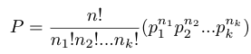
Similarly: Multinomial Distribution
Probability distribution of the outcomes from a multinomial experiment.
k possible outcomes each with a probability p_{k}
n trials
The probability each event E_{i} occurs n_{i} times given the probability for that outcome is p_{i}
Distribution gives probability of getting a certain an outcome a certain number of times for all the trials
Thus sampling gives the number per outcome
Sampling gives outcome

Slide 5
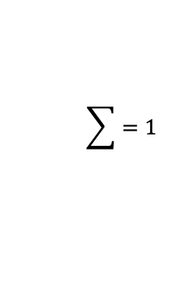
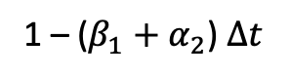
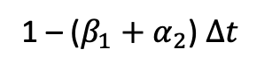
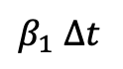
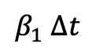
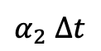
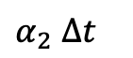
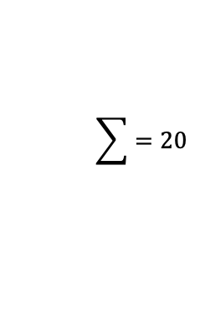
Voltage-Gated Calcium Channel
1 – ($β_{1}+α_{2}$) $∆t$
C0
$β_{1}$ $∆t$
C1
$α_{2}$ $∆t$
C2
$α_{2}$ $∆t$
$β_{1}$ $∆t$
1 – ($β_{1}+α_{2}$) $∆t$
n = 1 channel
0
1
0
$$\sum{=1}$$
n = 20 channels
4
9
7
$$\sum{=20}$$

Slide 6
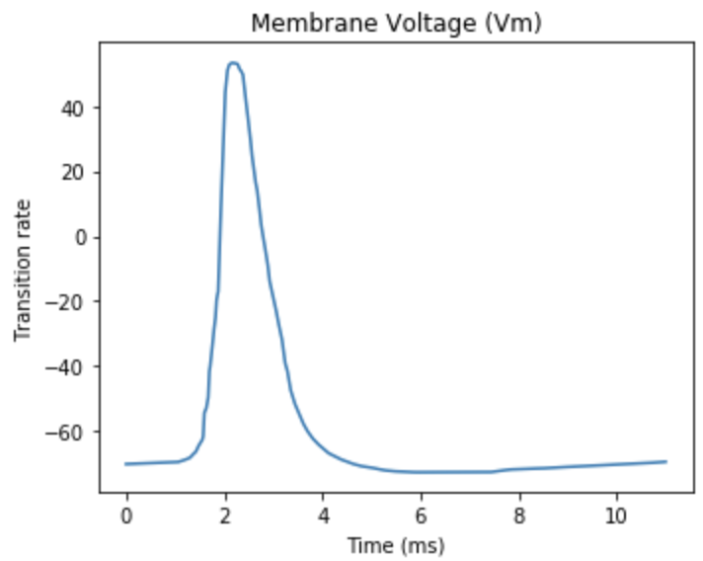
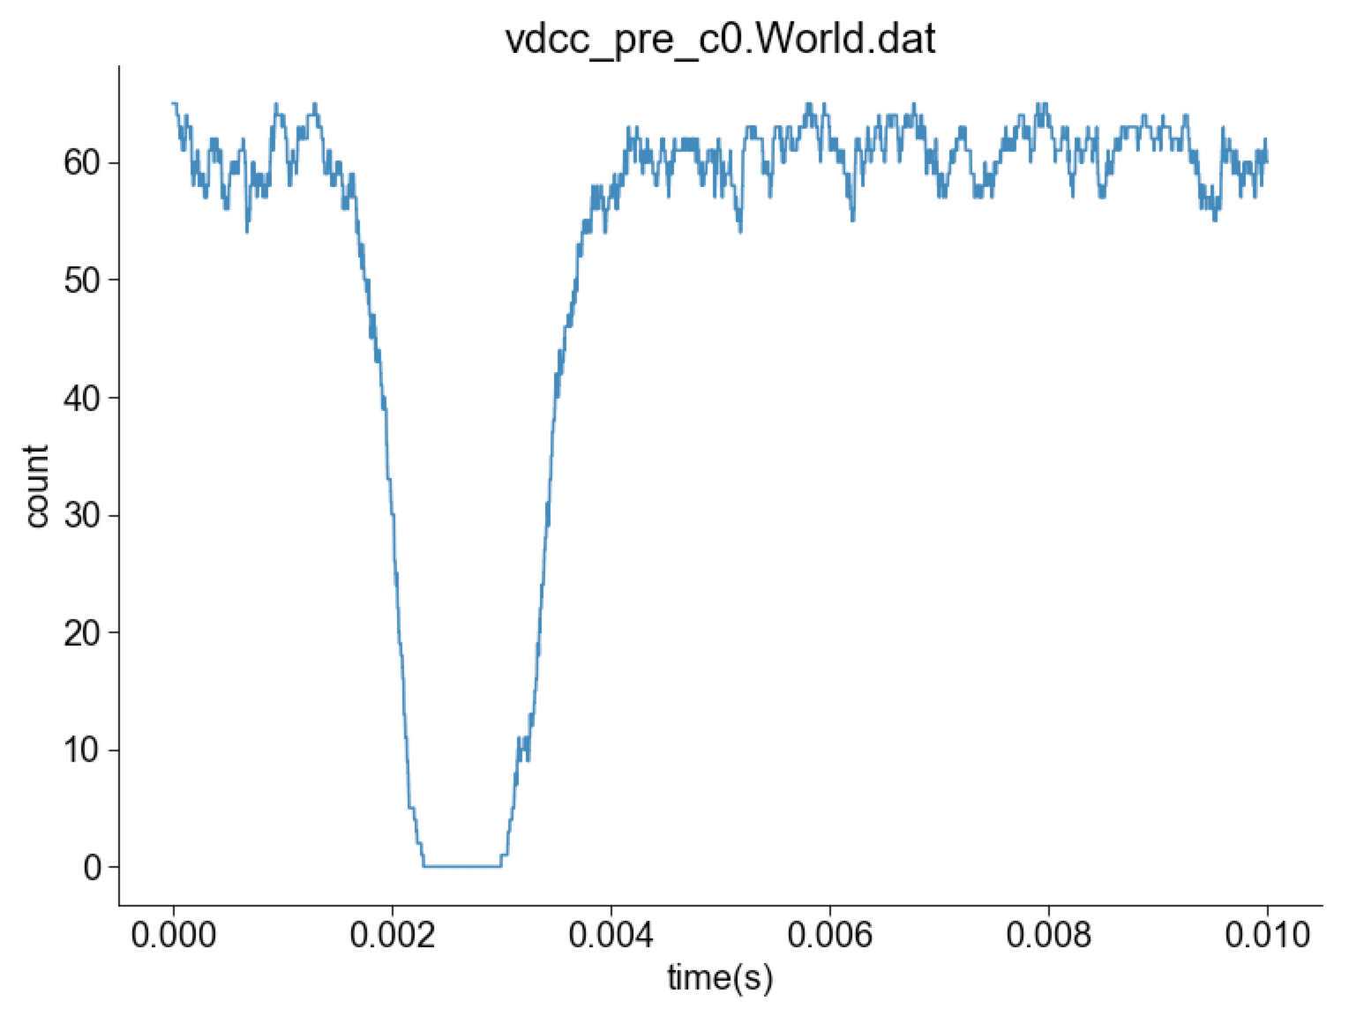
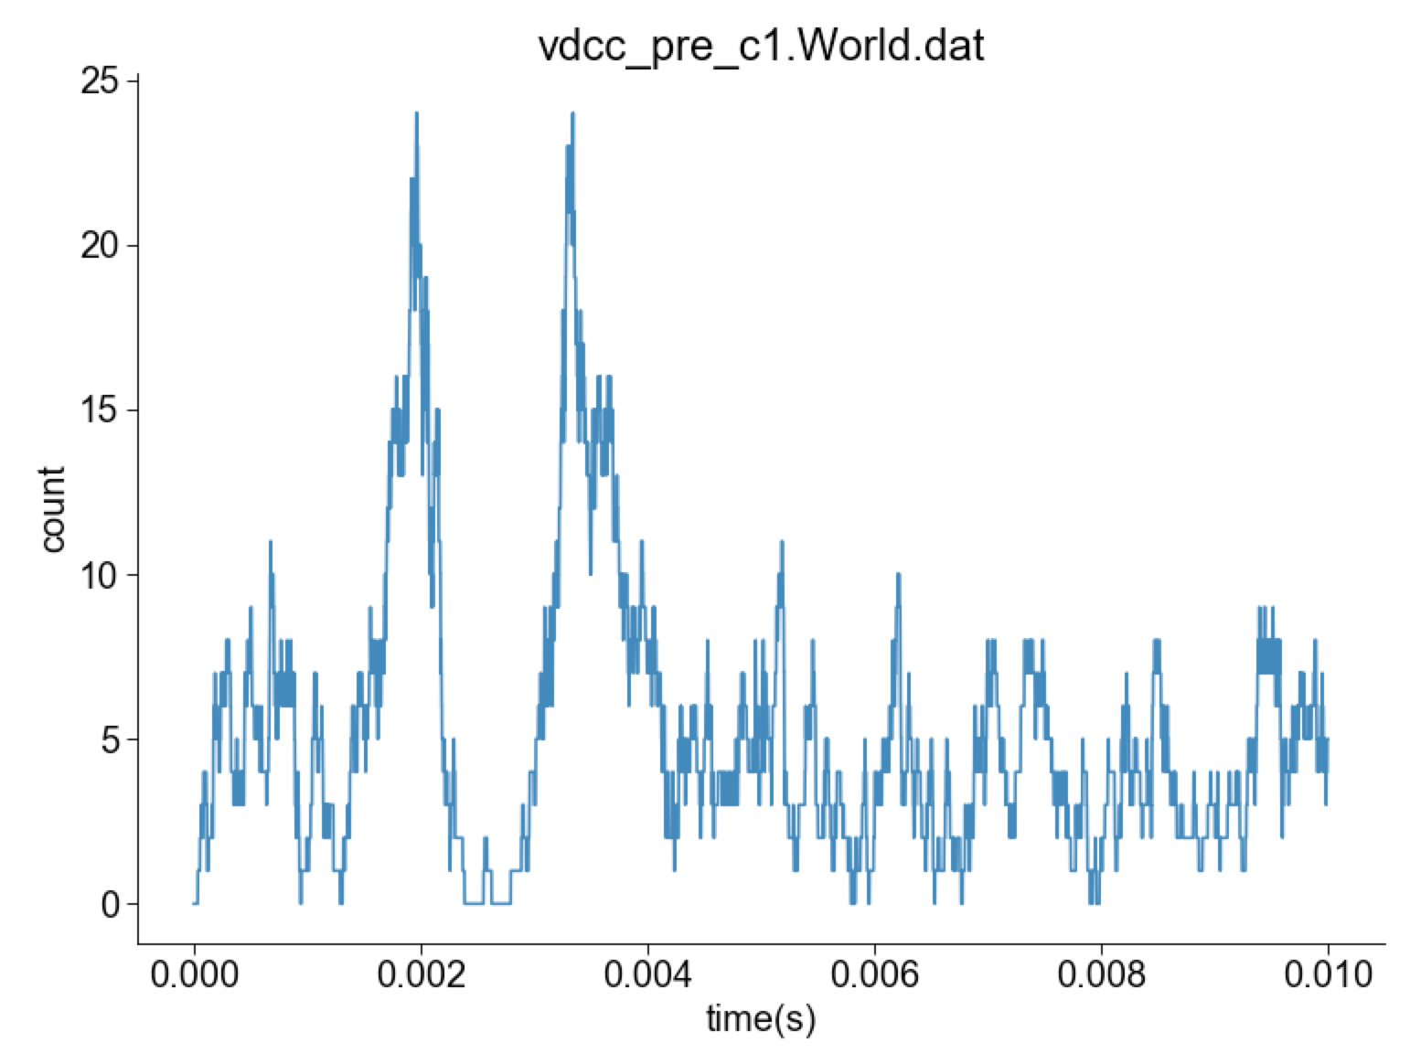
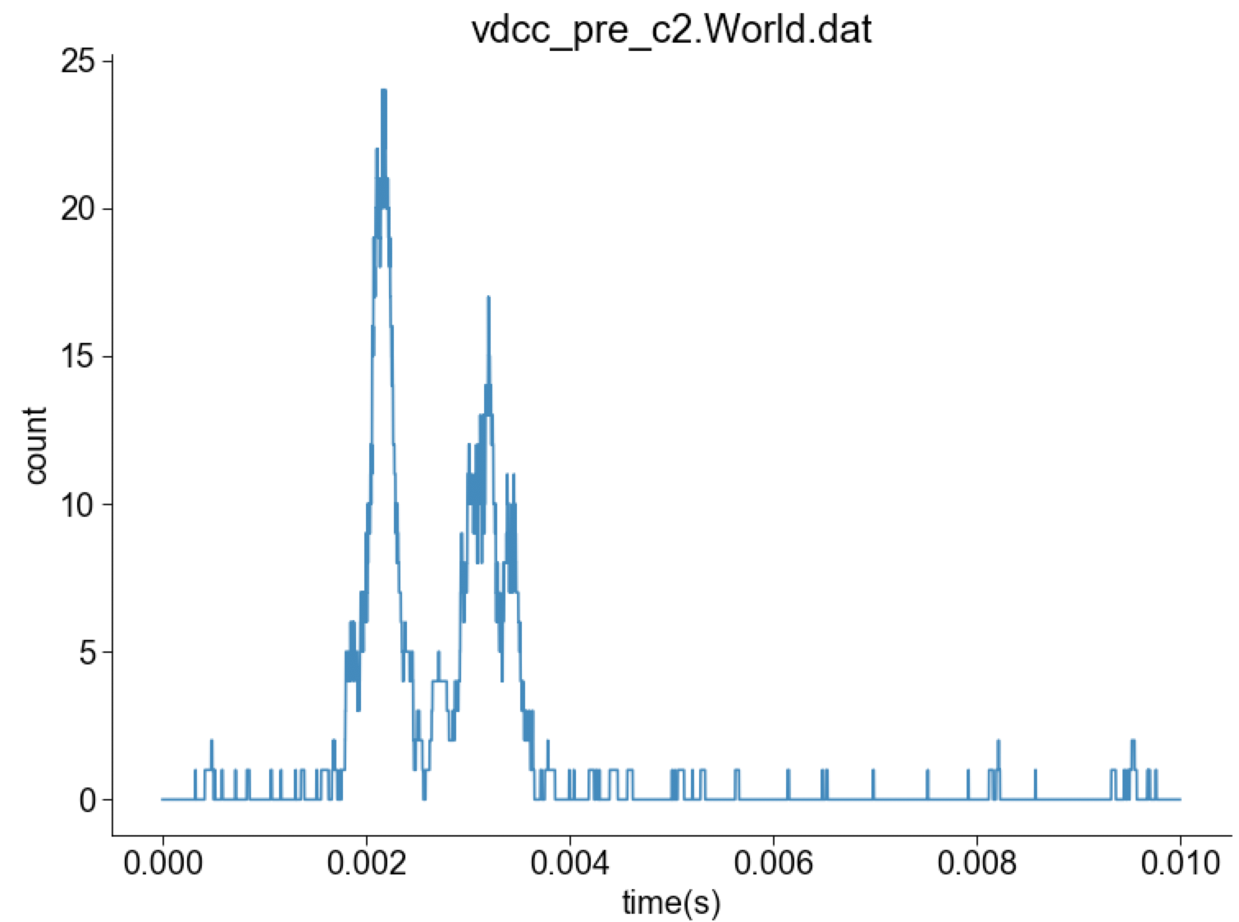
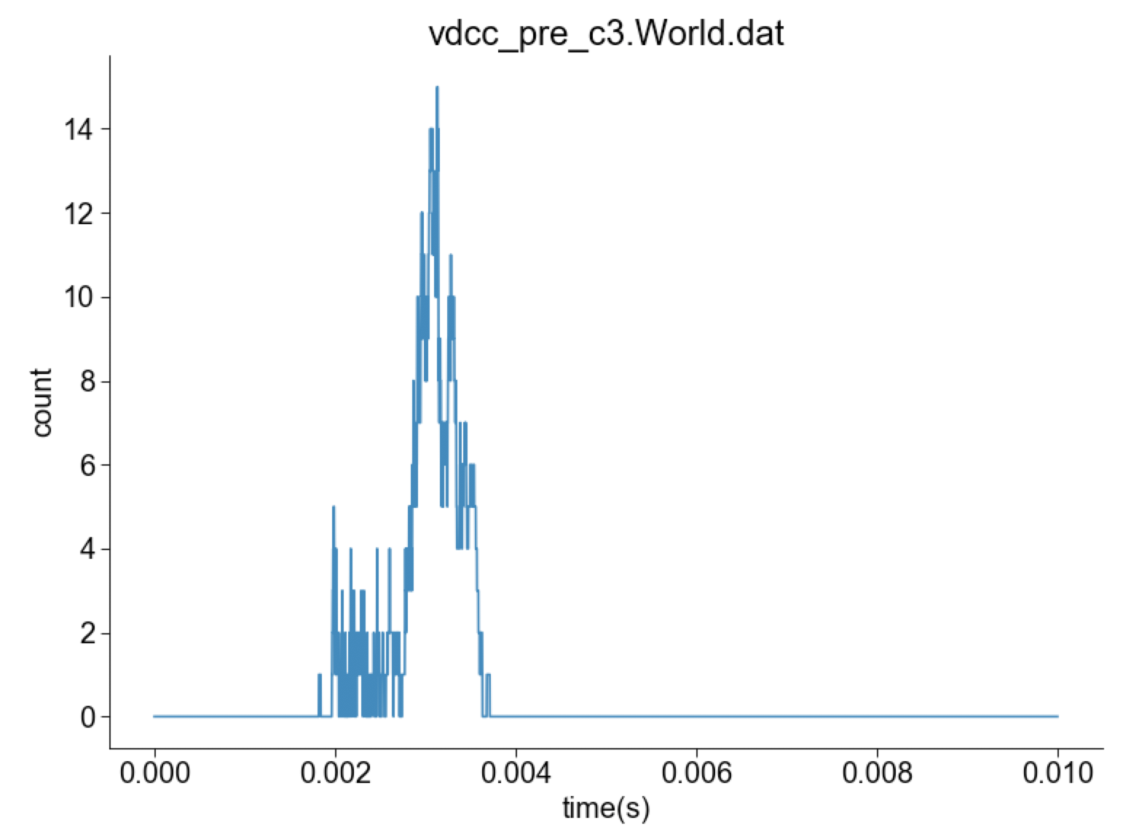
Voltage-Gated Calcium Channel

Slide 7
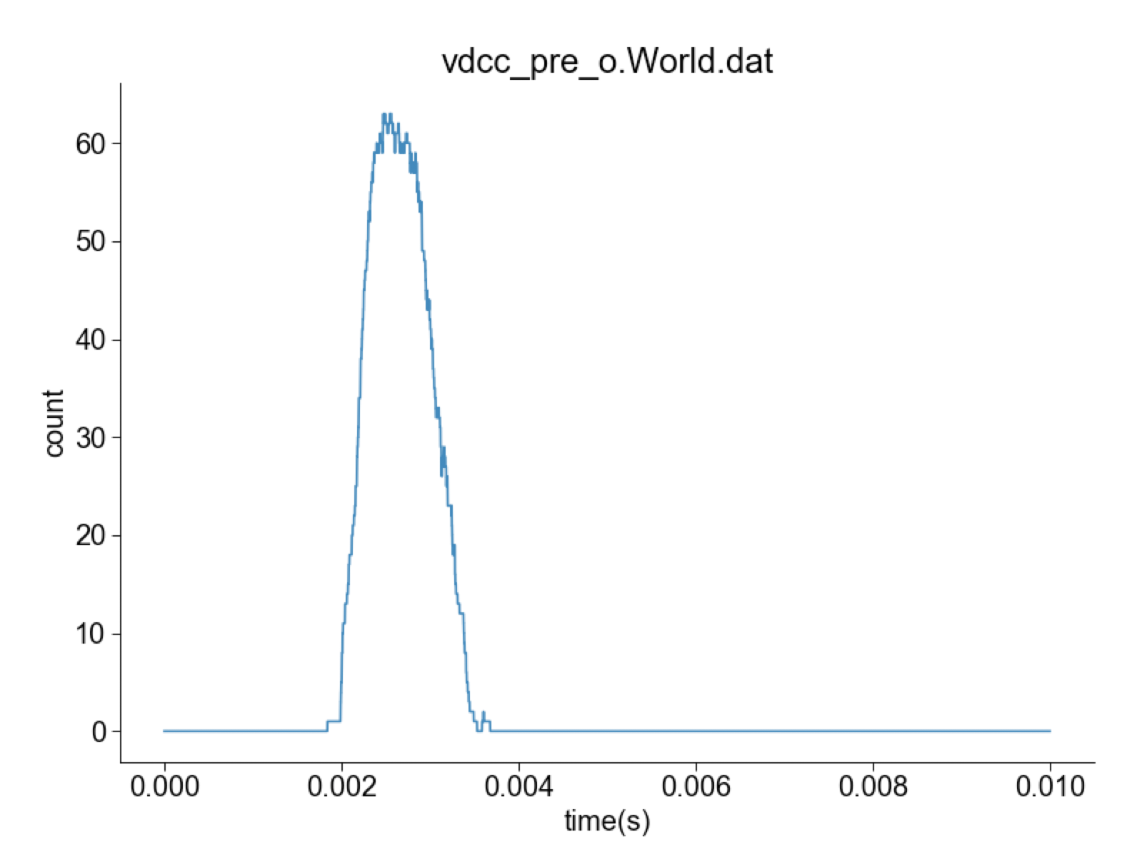
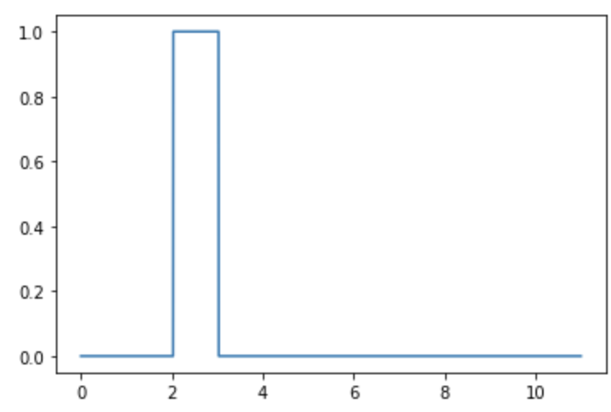
Voltage-Gated Calcium Channel

Slide 8
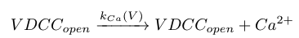
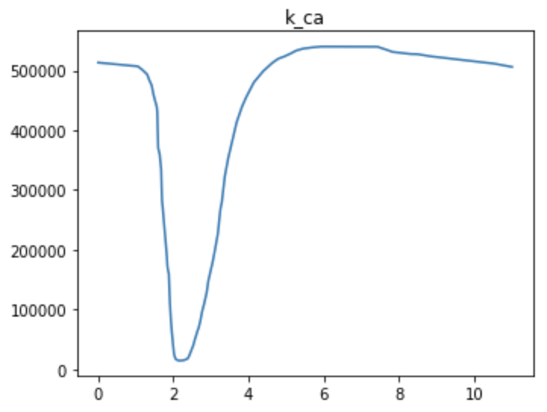
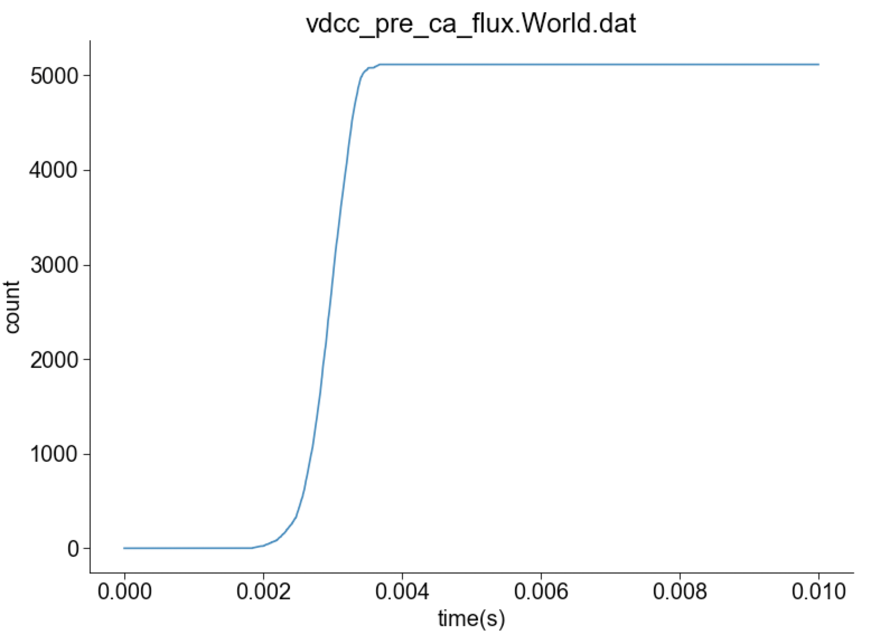
Calcium

Slide 9
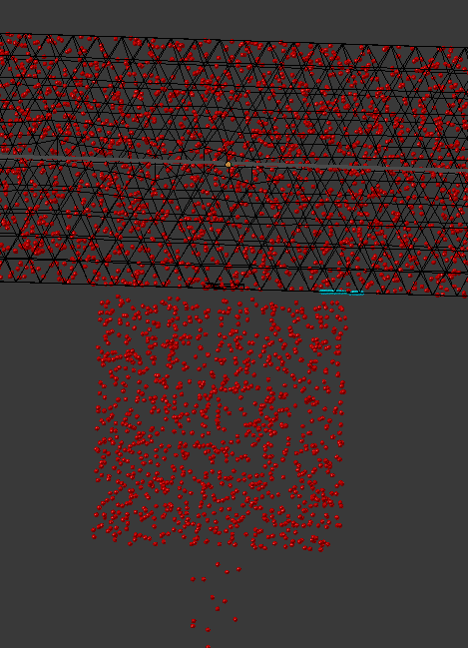
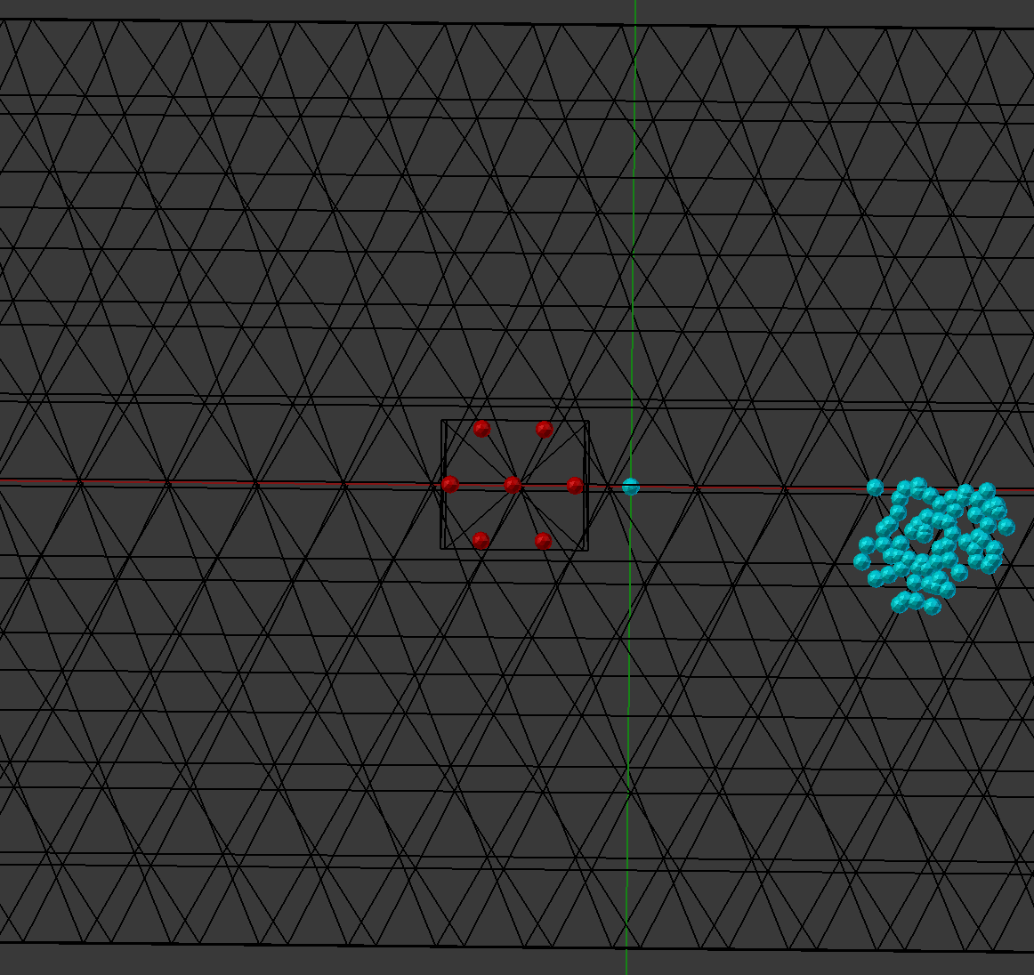
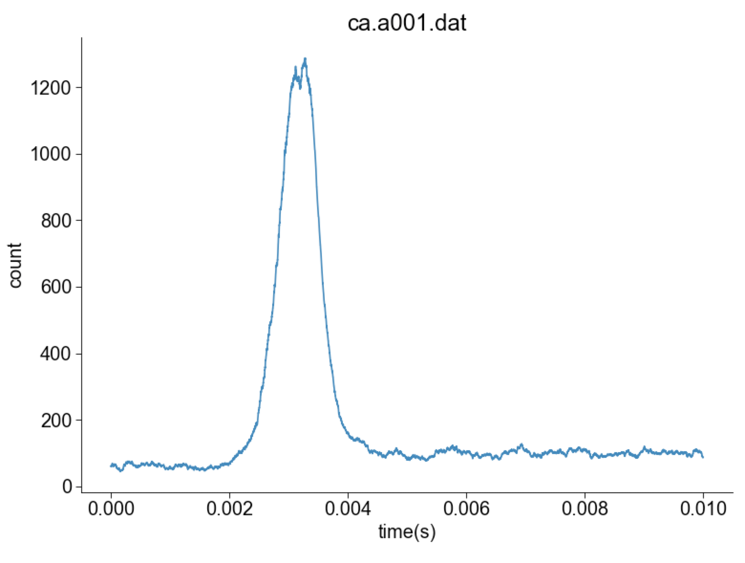
Calcium
calbindin bound
CB
SNARE
Free Ca²⁺
SB
At the SNARE complex
P from MCell

